Slide 1

Industrial interaction on
Front end development
Auscan academy of information Technology pvt. Ltd.
AKSHAT BHATT 2015225

Slide 2


CONTENTS
INTRODUCTION
ABOUT THE COMPANY
WORK DETAILS
SKILLS LEARNED
SUMMARY

Slide 3

INTRO
The internship was carried out digitally, the intern must have to accomplish all of the tasks allocated to them in order to complete the internship. Each task was an individual assignment, and no group work was permitted. The intern had to be able to complete each task within the allotted time frame for it to be considered a success.
A2IT provided the environment and necessary resources for the successful completion of the internship.

Slide 4
About the company
A2IT is an industrial training company in Mohali Chandigarh which stands for Auscan Academy of Information Technology Pvt. Ltd. A2IT is an experienced SaaS software development company with an award-winning portfolio. With the experience of working with more than 20 Fortune 200 companies, we have developed applications that are now being used by millions of consumers around the world.
A2IT provides is a software development company with strong skills in:
Web development.
UX | UI design.
Mobile app development (iOS and Android).
And many more.

Slide 5
work details
As a front-end developer, the major duties included determining the structure and design of web pages, striking a balance between functional and aesthetic design, and ensuring web design is optimized for smartphones. Working in an Agile, collaborative environment to understand requirements, design, code, and test innovative applications, and support those application. It requires the user to be skilled in in UI Development technologies such as HTML, CSS, JavaScript.
The internship included of total four tasks that were to be completed for the successful completion of the internship. The task ranked up from basics to intermediate level as follows:

Slide 6
Tasks
TASK 1
Created a simple landing page for a edtech teaching platform using HTML, CSS and bootstrap.
TASK 2
Making a simple To-Do app using HTML, CSS and JavaScript. This app helps list tasks.
TASK 3
Making a Personal Portfolio to showcase one's talents and skills, also to add our resume.
Final task was to make a Basic Banking system which can show customers and transaction history.
TASK 4

Slide 7
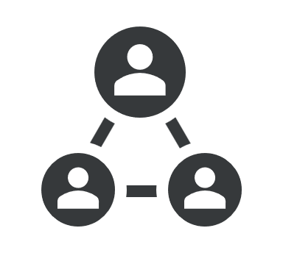


Skills learned
html
css
javascript
Basic concepts (www and & HTTP, client server communication).
Basic HTML (tags, element, attributes, paragraphs, headings, table, font, images, background).
HTML Forms (input, text fields, password, checkbox, combo-box, radio box, text areas, files, buttons).
Basic CSS (selector, internal, external, inline, class, id, background, font, text, padding, margin, border, hovering and elements).
Advance CSS (border-radius, opacity, cursor, layers, position, display, float, gradient and multiple-column).
Template design using CSS div.
Basic JavaScript (syntax, enable, location, operators, variables, events, alert, confirm, prompt, POP up, date, print)
JavaScript string (strings, length, split, search, replace)
JavaScript Events (onchange, onclick, onmouseover etc)
Document Object Model

Slide 8

SUMMARY
In conclusion, I can say that this internship was a great experience. I acquired deeper knowledge concerning my technical skills, but I also personally benefited. Currently HTML is a common part of web applications, and it is one of the most popular languages for web designing used by professionals worldwide. If we surf internet, we can see millions of websites designed with HTML and CSS. Indeed, I grew more independent in work and in everyday life. I realized that I could do more things than I thought, like learning new things by myself. There are huge opportunities available for the students who want to work in this field.

Slide 9
THANK YOU
AKSHAT BHATT
2015225
ML

